Slide 1
Lecture 21:
5.4.1. South Asia & Middle East
Brad DeLong
Department of Economics & Blum Center, U.C. Berkeley; & WCEG
last revised: Th 2020-04-02
for presentation: Th 2020-04-09
Original course by Melissa Dell (Harvard Econ 1342), revised by Brad DeLong
<https://github.com/braddelong/public-files/blob/master/econ-135-lecture-20.pptx>
<https://www.icloud.com/keynote/0xRRhkj7cn2vsAXbYKCH4E9Ug>

Slide 2
Discussion
South Asia & Middle East:
What strikes you as important here?

Slide 3
Asia
Tu Apr 14: 5.4. Asia:
Read Before: Sevkut Pamuk (2014): Institutional Change and Economic Development in the Middle East, 700-1800 <https://github.com/braddelong/public-files/blob/master/readings/article-pamuk-middle-east.pdf>
Slides: <https://github.com/braddelong/public-files/blob/master/econ-135-lecture-21.pptx>
Discussion Thread: <>
Zoom Q&A Session: <>
Asia is really big!
Just look at a few places:
Ottoman Empire:
Qing China:
Dutch colonialism in Indonesia

Slide 4
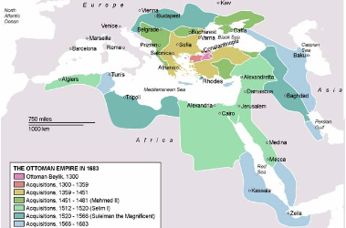
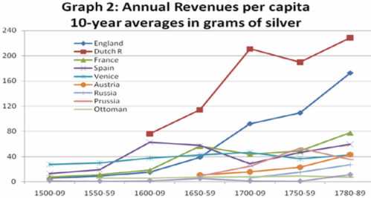
Ottoman Empire
Mehmet II “the Conqueror”’s army takes Constantinople in 1453
Most successful gunpowder empire of its day:
Biggest and most effective artillery park in the world
Best-disciplined infantry soldiers in the world: the janissaries
Highly-motivated professional, feudal, and conquistador cavalry: timarli sipahilar, kapikulu sipahilar, & akincilar
But in the Outer Empire state both predatory & weak:
Around 1800 in Egypt the Mamluks were extracting 2/3 of peasant incomes through taxes (Owen, p. 36).
In Anatolia about 50% (p. 37).
Owen: “not a situation which permitted any accumulation of capital in the agricultural sector nor any regular increase in production…”
4:00

Slide 5
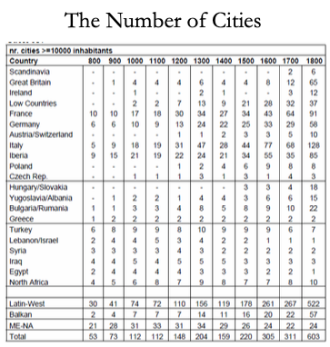
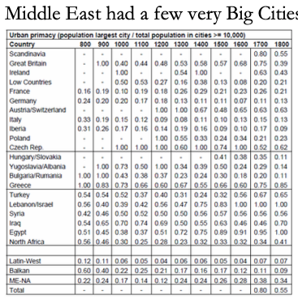
Urbanization
The Ottoman Empire had a few very large cities:
Parasitic rent extraction-funded cities…
4:00

Slide 6
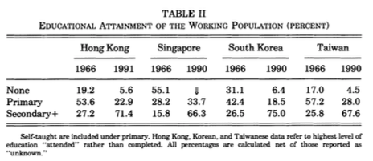
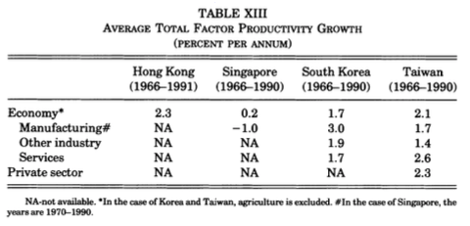
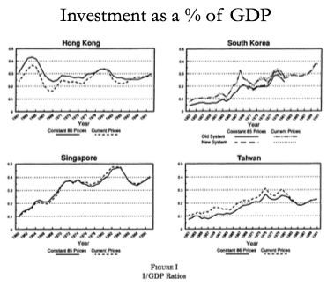
Qing Dynasty China
Factor accumulation and technology transfer:
Factor accumulation
Highest savings rates in the world
Massive educational expansion
Rapid transfer from farm to city, and from agriculture to manufacturing
Where did demand for manufactured goods come from?
The Japanese state: rich country-strong army
The open world economy: neocolonial origins of comparative development
State capitalism with Chinese characteristics (and utopian socialist aspirations)
Yet also:
Getting institutions and incentives right
Success at technology transfer
Avoiding rent-seeking and other elite-corruption political economy traps
4:00

Slide 7
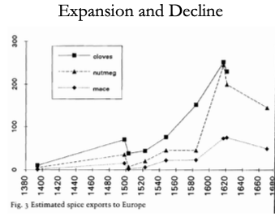
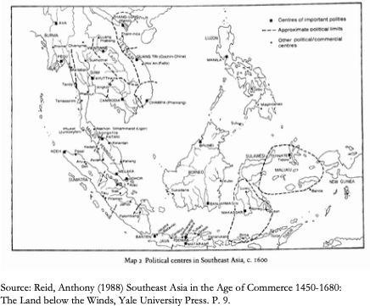
Dutch Colonial Indonesia
In the 16th century, Java (in modern Indonesia) and Malaysia were amongst the most urbanized places in the world:
Then the Dutch show up, with ships and cannon and muskets and well-drilled infantry…
And by 1900 Indonesia is very poor…
Ambon and Banda:
In Ambon the V.O.C. took over the existing feudal structure, which they used to monopolize supply.
In Banda, the V.O.C.:
killed most of the population in 1621 (probably over 20,000 people)
reorganized the production of nutmeg
established slavery system
ex-employees of the VOC as planters
“Comprador” elites…
De-economization: Reid (1993, Chapter 5): “When a Dutch factor visited Magindanao in 1686 he was told “Nutmeg and cloves can be grown here, just as in Malaku. They are not there now because the old Raja had all of them ruined before his death. He was afraid the Dutch Company would come to fight with them about it…”
4:00

Slide 8
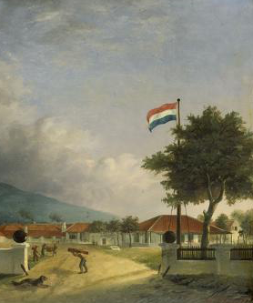
The Dutch Cultivation System on Java
Java was the center of the Dutch colonial empire:
Forced sugar cultivation 1830-1880 on the northern coast of Java
94 water-powered processing factories
Villages within three miles forced to grow cane
2.5M forced workers in the sugar sector
What happens to a village close to a factory?
People living near historical sugar factories more likely to be working in manufacturing in the late 20th century
More infrastructure near historical factories
Villages forced to grow sugar cane:
Have more village-owned land
Modest boost to education
More workers in secondary and tertiary sectors
4:00

Slide 9
Big Ideas: Lecture 21: South Asia & Middle East
Takeaways from this class:

Slide 10
Roadmap for the Next Two Weeks…
6. Policy Issues
22. Th Apr 16: 6.1. "Deep Roots" vs. Path Dependence
Read Before: Nathan Nunn (2012): Culture and the Historical Process <https://delong.typepad.com/files/nunn-culture.pdf>
Read Before: Melissa Dell (2015): Path Dependence in Development: Evidence from the Mexican Revolution <https://scholar.harvard.edu/files/dell/files/revolutiondraft.pdf>
Slides: <https://github.com/braddelong/public-files/blob/master/econ-135-lecture-22.pptx>
23. Tu Apr 21: 6.2. Growth and Fluctuations; Trade and Development, Foreign Aid
Read Before: Barry Eichengreen (2015): Hall of Mirrors: The Great Depression, The Great Recession, and the Uses-and Misuses-of History, selections <https://delong.typepad.com/files/eichengreen-mirrors.pdf>
Read Before: David Atkin (2014): Endogenous Skill Acquisition and Export Manufacturing in Mexico <https://delong.typepad.com/files/atkin-skill.pdf>
Slides: <https://github.com/braddelong/public-files/blob/master/econ-135-lecture-23.pptx>
24. Th Apr 23: 6.3. Populism, Plutocracy, Kleptocracy, & Neo-Fascism
Read Before: Ernest Gellner (1973): Nations & Nationalism, selections <https://delong.typepad.com/files/gellner-nations.pdf>
Read Before: Barry Eichengreen (2018): The Populist Temptation Economic Grievance & Political Reaction in the Modern Era, selections <https://delong.typepad.com/files/eichengeeen-populist.pdf >
25. Tu Apr 28: 6.4. Global Warming
Read Before: Melissa Dell et al. (2012): Temperature Shocks & Economic Growth: Evidence from the Last Half Century <https://scholar.harvard.edu/files/dell/files/aej_temperature.pdf>
Read Before: Melissa Dell et al. (2014). What Do We Learn from the Weather? The New Climate-Economy Literature, selections <https://economics.mit.edu/files/9138>

Slide 11
Roadmap Following…
Th Apr 30: 6.5. The Pace and Meaning of Economic Growth
Read Before: William Nordhaus: Do Real-Output and Real-Wage Measures Capture Reality? <https://www.nber.org/chapters/c6064.pdf>
Read Before: John Maynard Keynes: Economic Possibilities for Our Grandchildren<<https://delong.typepad.com/files/keynes-persuasion.pdf>
Read Before: Edward Bellamy (1887): Looking Backward 2000-1887, selections <https://delong.typepad.com/files/bellamy-backward.pdf>
7. Conclusion
Tu May 5: 7. Conclusion: The Future?
Read After: Robert Allen (2011): Global Economic History: A Very Short Introduction, selections <https://delong.typepad.com/files/allen-geh.pdf >
W May 13 11:30-14:30: FINAL PAPER/PROJECT DUE

Slide 12
Catch Our Breath…
Ask a couple of questions?
Make a couple of comments?
Any more readings to recommend?

Slide 13
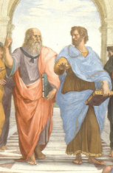
Notes, etc.…

Slide 14
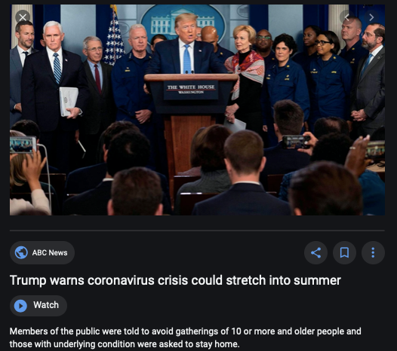
Coronavirus!

Slide 15
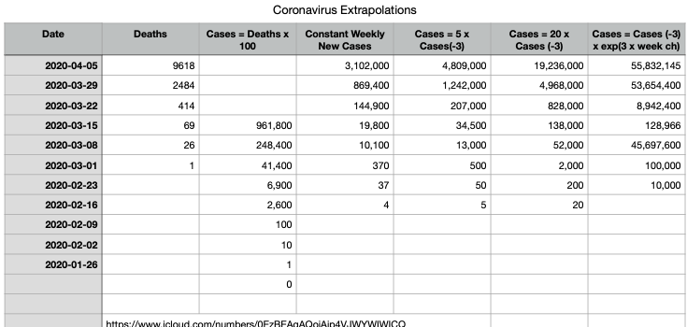
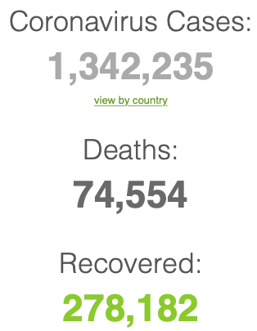
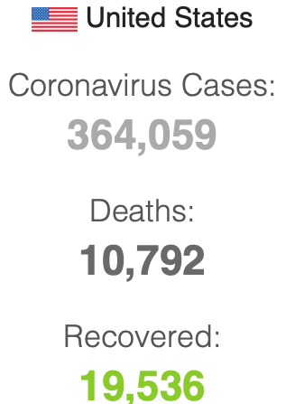
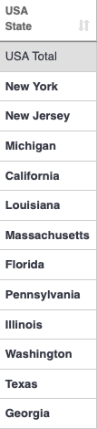
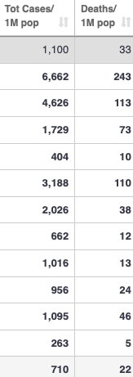
Coronavirus
Where we think we are, as of Th Apr 09:
We really do not know
No random samples…
If we extrapolate out the past week straight-line log:
We will have 440,000 deaths in three weeks
But it is unlikely to be that bad
Best thing I have read comes from Jim Stock <https://drive.google.com/file/d/12MV466ZZy5xHir4xdPhoTrL1oO8CbZU-/view>:
The basic SIR epidemiological model of contagion
The effect of social distancing and business shutdowns on epidemic dynamics enters the model through a single parameter: the case transmission rate β
Re-express the model in terms of β and the asymptomatic (or not very symptomatic) hence non-tested rate—the fraction of the infected who are not tested
The COVID-19 non-testing rate is unidentified in our model
Estimates in the epidemiological literature range from 0.18 to 0.86.
The asymptomatic rate could be estimated accurately and quickly by testing a random sample
The optimal policy response and its economic consequences hinge critically on the asymptomatic rate

Slide 16
Coronavirus II
We do not really know where we are, as of Mo Apr 6:
Best thing I have read comes from Jim Stock <https://drive.google.com/file/d/12MV466ZZy5xHir4xdPhoTrL1oO8CbZU-/view>:
The basic SIR epidemiological model of contagion
The effect of social distancing and business shutdowns on epidemic dynamics enters the model through a single parameter: the case transmission rate β
Re-express the model in terms of β and the asymptomatic (or not very symptomatic) hence non-tested rate—the fraction of the infected who are not tested
The COVID-19 non-testing rate is unidentified in our model
Estimates in the epidemiological literature range from 0.18 to 0.86.
The asymptomatic rate could be estimated accurately and quickly by testing a random sample
The optimal policy response and its economic consequences hinge critically on the asymptomatic rate

Slide 20
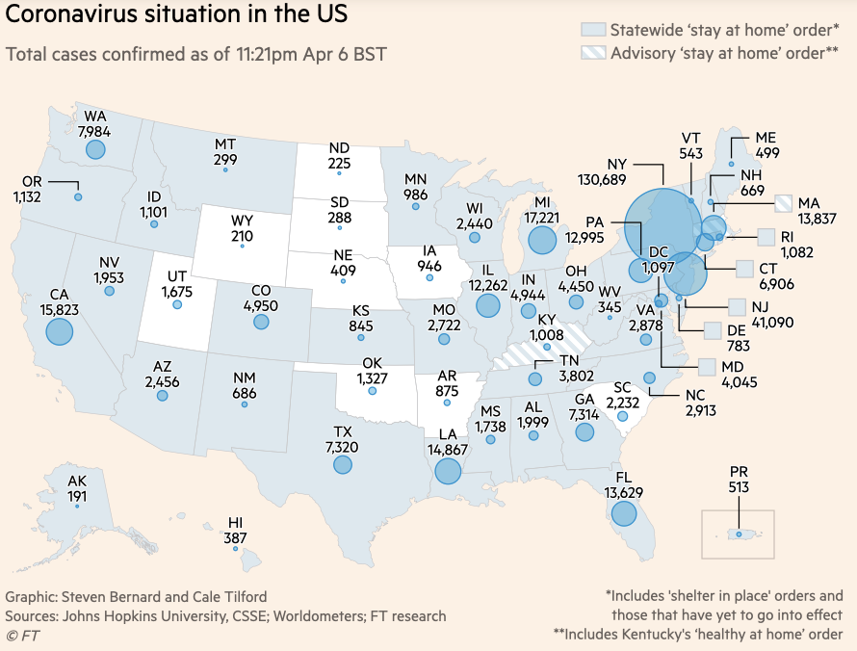
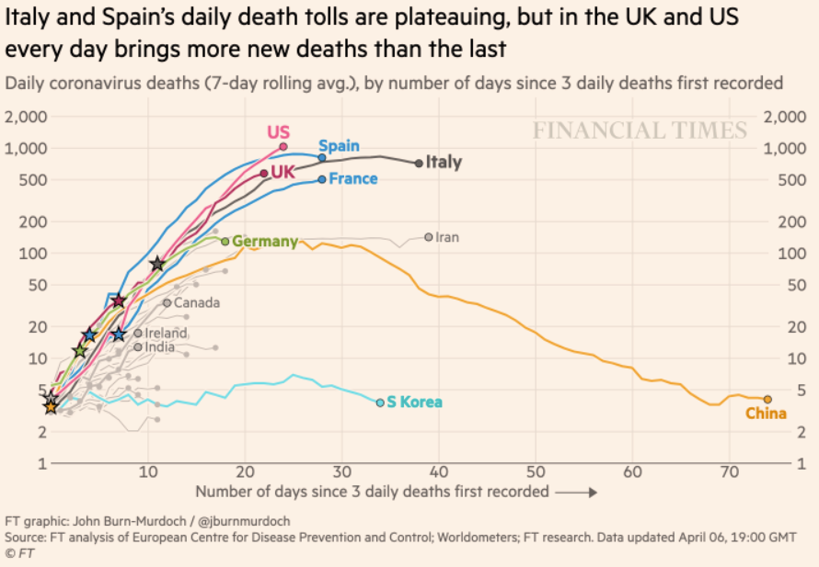
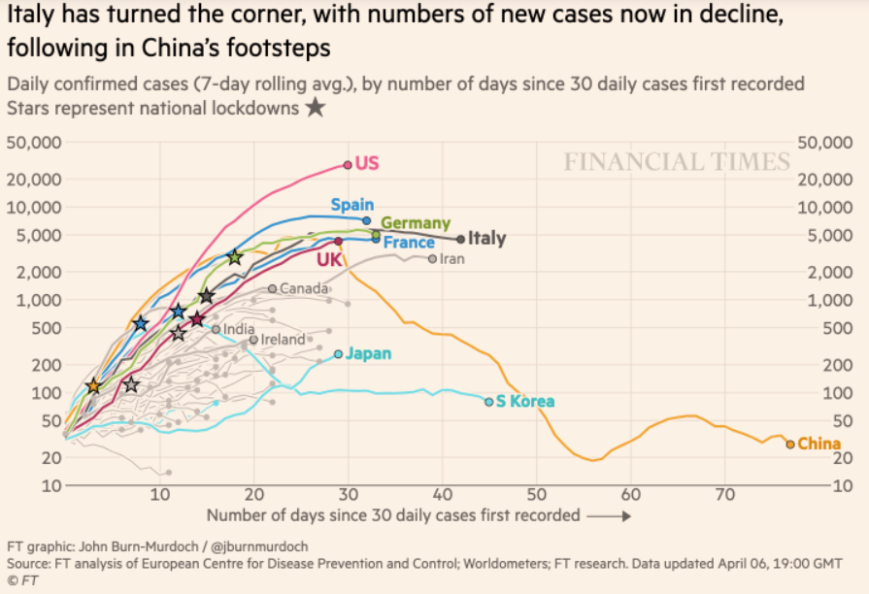
Financial Times Graphs Blown Up…

Slide 24
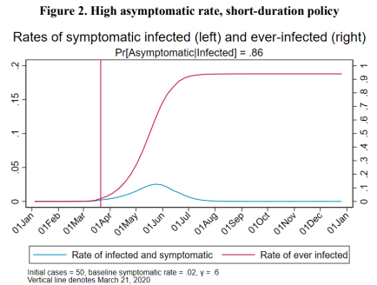
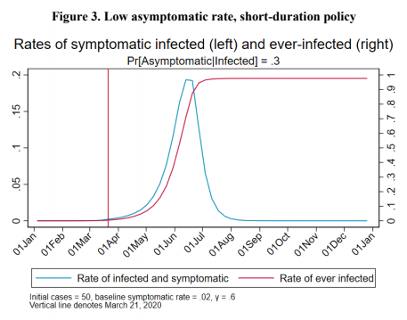
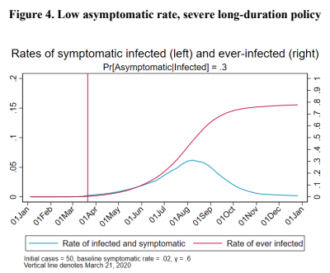
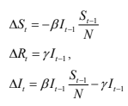
James Stock (2020)
Standard SIR model:<https://drive.google.com/file/d/12MV466ZZy5xHir4xdPhoTrL1oO8CbZU-/view>:
Susceptible, Infected, Recovered (& immune), transmission rate β, recovery rate γ, reproduction number R0, asymptomatic hence non-tested rate π0
Calibration: half-life of infection one week: γ = 0.5, s0 = 0.02, 50 cases on Jan 24
For March 21, 2020, the positive test rate in the United States is approximately 10%…
<https://drive.google.com/file/d/12MV466ZZy5xHir4xdPhoTrL1oO8CbZU-/view>

Slide 29
Bringing the Economy Back Up from Anæsthesia
Major issues:
Certificates of immunity:
Which requires test, test, test:
And not just disease virus tests
Presence-of-antibodies tests
How quickly can we match the immune with public-contact jobs?
What jobs can be done with minimal infection risk?
What minimal-infection substitutes can we find for previous jobs?
How quickly can restrictions be relaxed without the virus coming roaring back?
How do we avoid having the market give a “shutdown” signal to enterprises we in fact want restarted?
Which is pretty much all of them
How much of the potential caseload do we want to push out beyond the vaccine-arrival date?
ALL THESE QUESTIONS ARE ANSWERABLE IF WE LEARN THE ASYMPTOMATIC HENCE NON-TESTED RATE!!

Slide 30
Keeping the Economy from Crashing During the Lockdown
Nick Rowe: We have a 50% output cut in 100% of the sectors:
A temporary 100% output cut in 50% of the sectors (what the Coronavirus does) is very different from a 50% output cut in 100% of the sectors
Nick’s thought experiment:
In three months we are going to invent unobtanium:
Substantial intertemporal substitutibility
Plus lower cross-good contemporaneous substitutitbility
Hence high desired savings rate now
Flex-price market thus produces a nominal rate at the zero lower bound and a high inflation rate over the next three to six months
Plus liquidity-constrained workers in affected sectors see their demand go to zero immediately
Can we get there? Should we get there? What should we do instead?
We need a good RBC economist: are there any?…
<https://worthwhile.typepad.com/worthwhile_canadian_initi/2020/03/relative-supply-shocks-unobtainium-walras-law-and-the-coronavirus.html>

Slide 31
Keeping the Economy from Crashing During the Lockdown II
Nick Rowe:
<https://worthwhile.typepad.com/worthwhile_canadian_initi/2020/03/relative-supply-shocks-unobtainium-walras-law-and-the-coronavirus.html>
Plus: to extend the thought experiment:
We just lost the ability to make “unobtainium”
So we should be substituting leisure for work, and moving workers into relatively unproductive labor, making the commodities we can still produce right now
How should relative prices move as a result? How should we make them move?
Plus: distributional issues
Plus: bankruptcy and credit chain issues

Slide 32
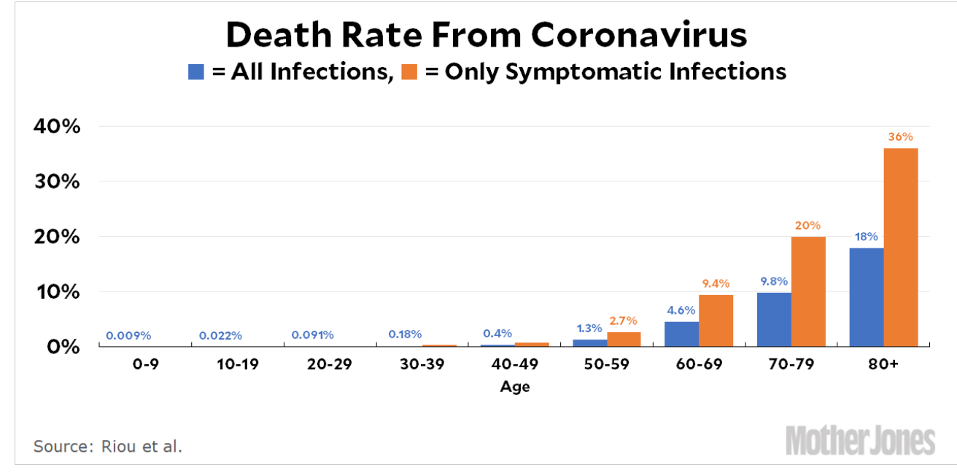
MOAR Coronavirus!
Death for Geezers!
Mortality for the Youngs very low…
It’s the flu for them—for you…
And an extra doubling—or is it 5%?—mortality for the asthmatic
And an extra doubling—or is it 5%?—mortality for the overweight

Slide 33
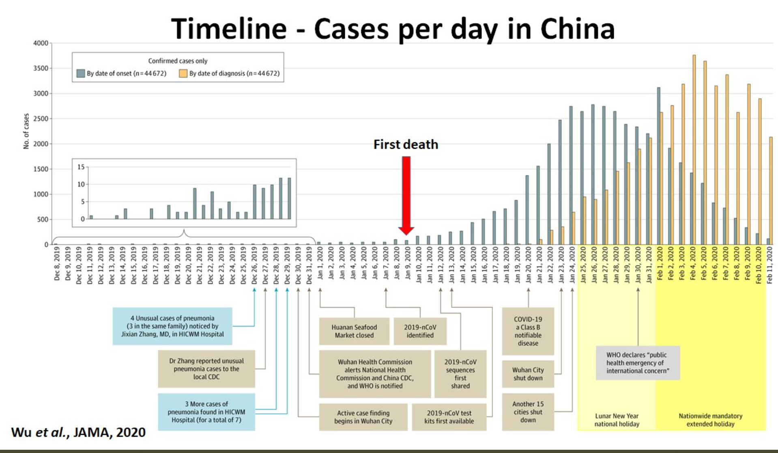
What We Think Happened in Wuhan
China beat it quickly & relatively easily!
We think
Shut down Wuhan when 200 cases per day
That seems to have been a good decision

Slide 34
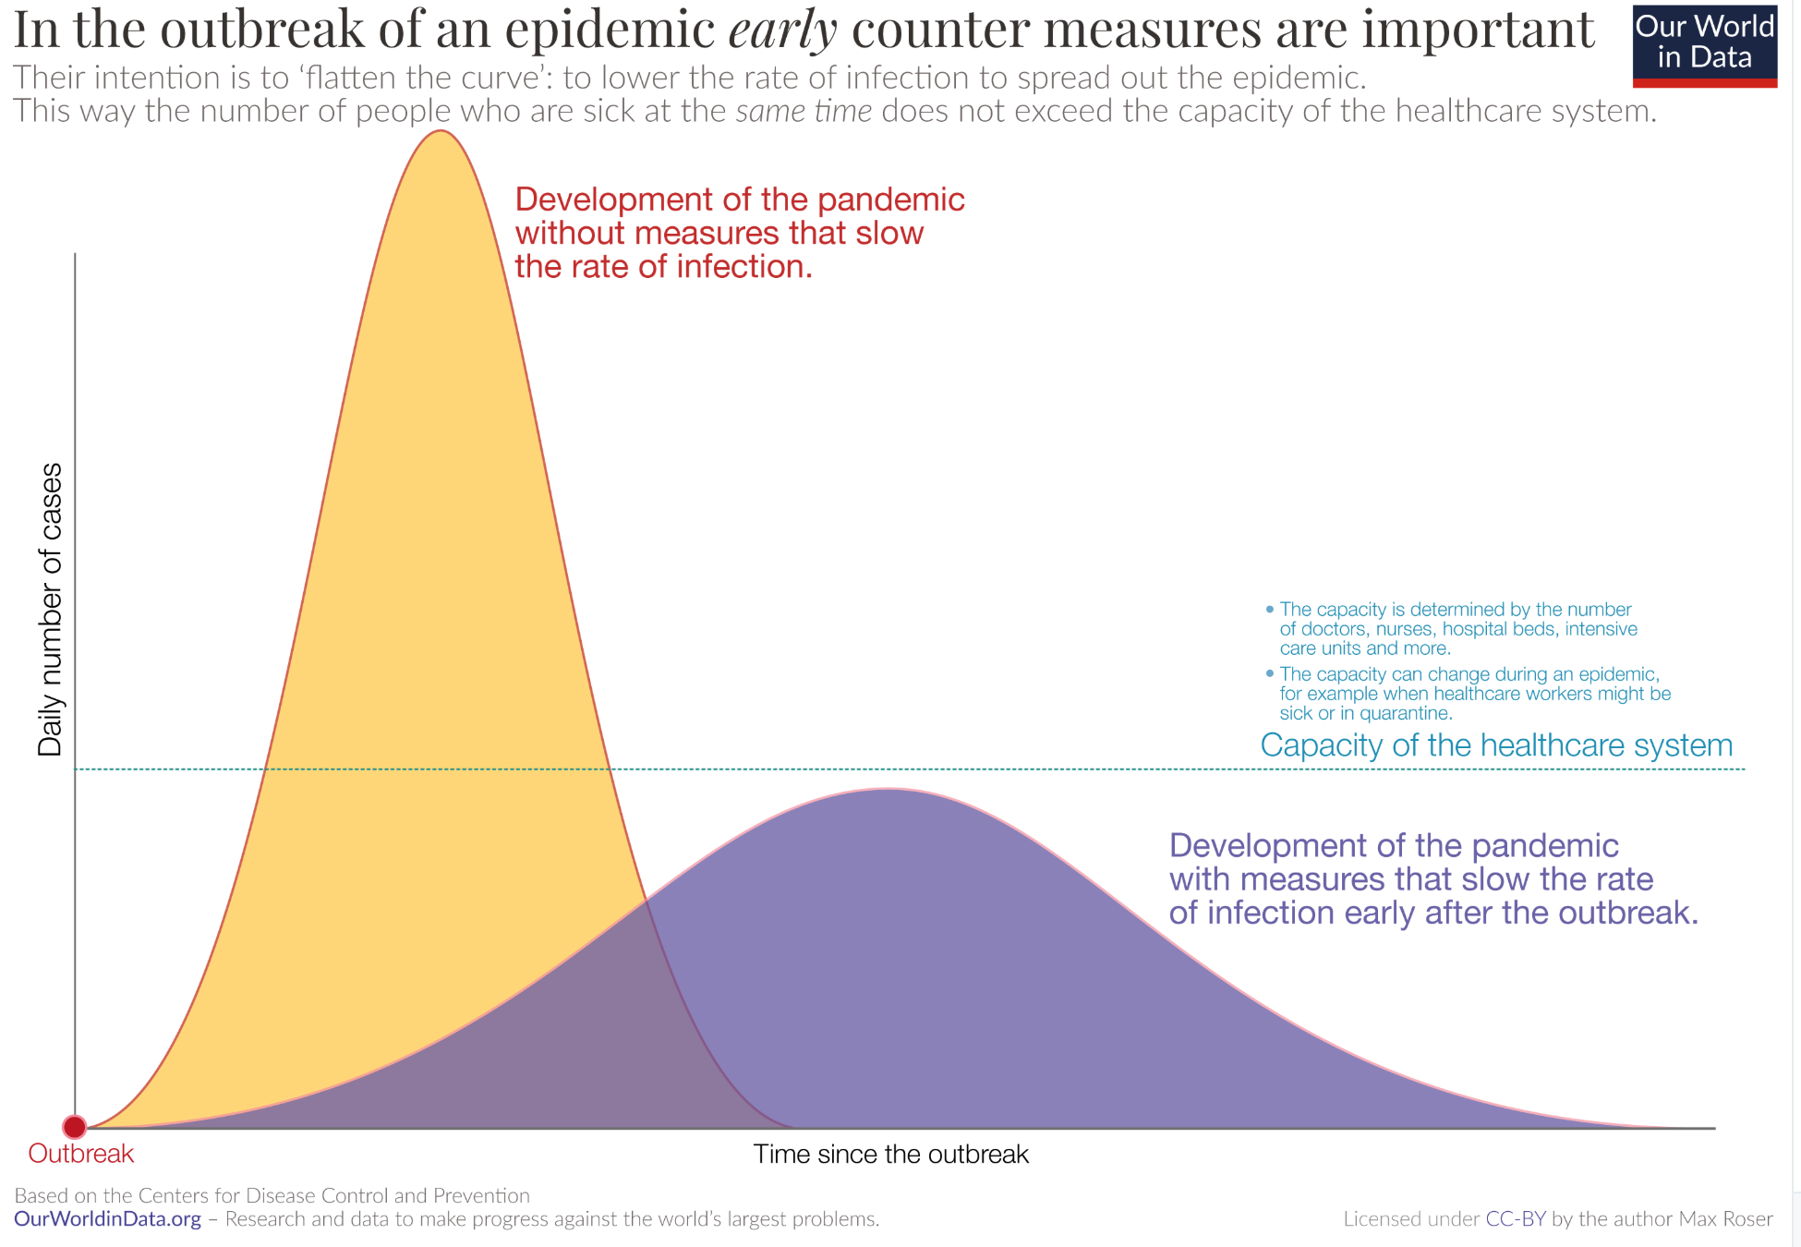
The Goal
When Is It Appropriate to Move on This?
Immediate social distancing…
Self-isolate if you have a cough and a fever…
Hope that warmer temperatures will do to this what they did to SARS…
Otherwise, when do you want to start spreading out transmission. It seems that early is as good as later, so do it early…
I have no good intuition on why you want to move early
Plus your moving early will be wasted if you get reinfected
Plus the sparks you throw off making others’ lives more difficult

Slide 35
References
Financial Times (2020): Coronavirus Tracked: The Latest Figures as the Pandemic Spreads <https://www.ft.com/coronavirus-latest>
Nick Rowe (2020): Relative Supply Shocks, Unobtainium, Walras' Law, and the Coronavirus <https://worthwhile.typepad.com/worthwhile_canadian_initi/2020/03/relative-supply-shocks-unobtainium-walras-law-and-the-coronavirus.html>
Jim Stock (2020): Coronavirus Data Gaps and the Policy Response <https://drive.google.com/file/d/12MV466ZZy5xHir4xdPhoTrL1oO8CbZU-/view>

Slide 36
MOAR Coronavirus!
What I am watching:
Max Roser & Hannah Ritchie: Coronavirus Disease (COVID-19) <https://ourworldindata.org/coronavirus>…
Worldometer: Coronavirus Update (Live) <https://www.worldometers.info/coronavirus/>: ‘125,599 Cases and 4,605 Deaths from COVID-19 Virus Outbreak…
FT Coronavirus Tracker <https://www.ft.com/content/a26fbf7e-48f8-11ea-aeb3-955839e06441>
Josh Marshall’s COVID Twitter List <https://twitter.com/i/lists/1233998285779632128>
NEJM Group: Updates on the Covid-19 Pandemic <http://m.n.nejm.org/nl/jsp/m.jsp?c=%40kxNtXckRDOq8oG0jJvAXsIzN4mPECIPhltxoTSdTU9k%3D&cid=DM89089_NEJM_COVID-19_Newsletter&bid=173498255>: 'From the New England Journal of Medicine, NEJM Journal Watch, NEJM Catalyst, and other trusted sources...

Slide 37
Catch Our Breath…
Ask a couple of questions?
Make a couple of comments?
Any more readings to recommend?
<https://www.icloud.com/keynote/0YKEi7HeOrVGvKYtt9FEqH7nA>
<https://www.bradford-delong.com/2020/04/coronavirus.html>
github:<https://github.com/braddelong/public-files/blob/master/coronavirus.pptx>
https://github.com/braddelong/public-files/blob/master/coronavirus.pdf>
html File: <https://www.bradford-delong.com/2020/04/coronavirus.html>
Edit This File: <https://www.typepad.com/site/blogs/6a00e551f08003883400e551f080068834/post/6a00e551f080038834025d9b3bd66a200c/edit>
<https://delong.typepad.com/files/2020-04-01-coronavirus.pdf>

Slide 38
Coronavirus! (March 16)
With 31 deaths in the U.S. as of March 11, a 1% death rate, and up to 4 weeks between infection and death, that means that as of Feb 12 there were 3100 coronavirus cases in the United States.
With 87 deaths in the U.S. as of Mar 16, a 1% death rate, and up to 4 weeks between infection and death, that means that as of Feb 17 there were 8700 coronavirus cases in the United States
If it is doubling every seven days, then now about 150,000 people have and in the next week about 150,000 more people in the U.S. will catch coronavirus—which means 1/2200, currently 3500 of the 7.6 million inhabitants of San Francisco Bay. Touch a hard surface that any of those 3500 has touched in the last 48 hours, and the virus has a chance to jump to you…
These numbers could be five times too big. These numbers are probably not five times too small unless the thing is a lot less deadly, and there are a lot of asymptomatic cases…
What is wrong with this analysis?

Slide 39
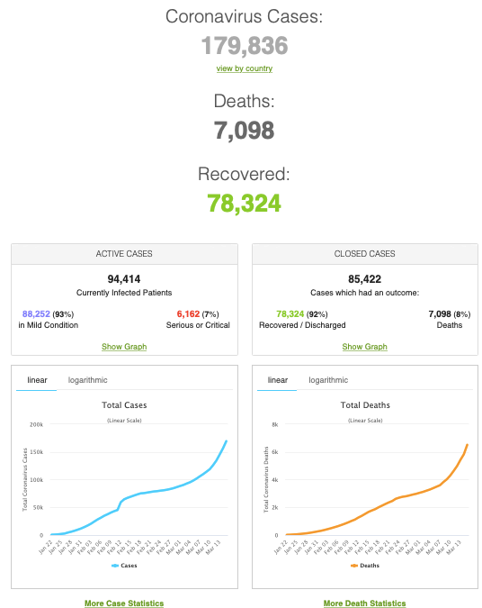
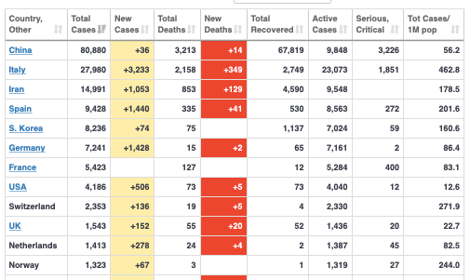
MOAR Coronavirus!
As of March 21: Things are not moving in the right direction:
What is the R0?
How can the R0 be changed?
How will the R0 change?
What is the asymptote share of the population?
What is the mortality rate?

Slide 40
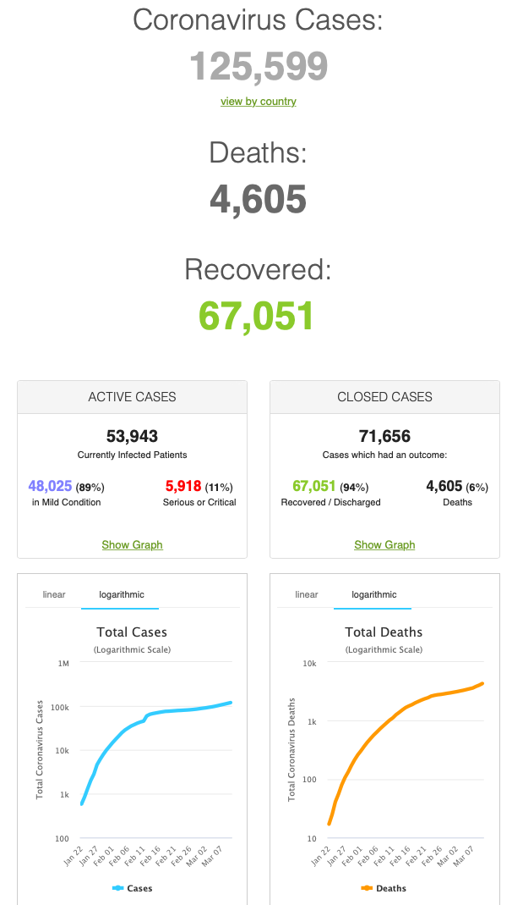
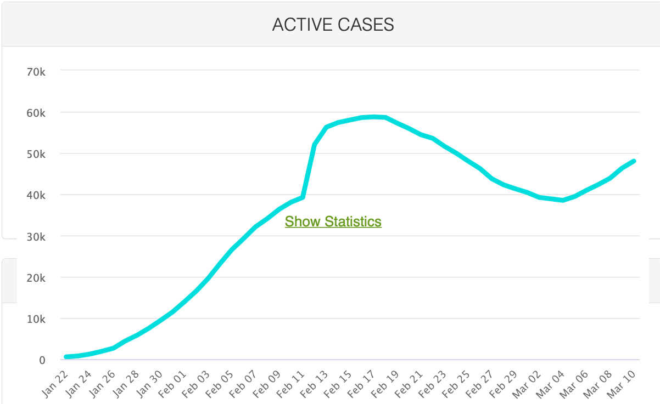
MOAR Coronavirus!
As of March 10: Things are not moving in the right direction:
What is the R0?
How can the R0 be changed?
How will the R0 change?
What is the asymptote share of the population?
What is the mortality rate?

Slide 41
Notes

